Slide 1

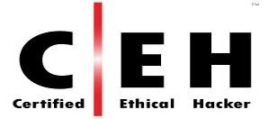
Moderator :
Alukwe -
+254720474923|+254780474923
cakhonya@kabarak.ac.ke alukchris@gmail.com

Slide 2
Information Systems Audit.
FIC4030 A
Day & Time:
Saturday 09:00am – 12:00hrs

Slide 3
Lecture 3
Planning IT Audit

Slide 4
Planning an Audit
As technology becomes more integral to the organization's operations and activities, a major challenge for internal auditors is how to handle companywide assessment of IT risks and controls within the scope of their overall assurance and consulting services.
Therefore, auditors need to understand the following.
Organization's IT environment.
Applications and computer operations that are part of the IT infrastructure.
How IT applications and operations are managed.
How IT applications and operations link back to the organization.

Slide 5
Planning an Audit
Completing an inventory of IT infrastructure components will provide auditors with information regarding the infrastructure's vulnerabilities.
The complete inventory of the organization's IT hardware, software, network, and data components forms the foundation for assessing the vulnerabilities within the IT infrastructures that may impact internal controls.
Once an adequate understanding of the IT environment has been achieved, the Chief Audit Executive (CAE) and the internal audit team can perform the risk assessment and develop the audit plan

Slide 6
Planning an Audit
Factors considered when developing the audit plan,
The organization's industry sector,
Revenue size,
Revenue type,
Complexity of business processes,
Geographic locations of operations.

Slide 7
Planning an Audit
Two other factors having a direct impact on the risk assessment and in determining what is audited within the IT environment are its components and role they play.
For example:
What technologies are used to perform daily business
functions?
Is the IT environment relatively simple or complex?
Is the IT environment centralized or decentralized?
To what degree are business applications customized?
Are some or all IT maintenance activities outsourced?
To what degree does the IT environment change every year?

Slide 8
Planning An Audit
In addition to factors impacting the risk assessment, it is important for CAEs (Chief Audit Executive) and internal auditors to;
Use an approach that ascertains the impact and likelihood of risk occurrence;
Use an approach that links back to the business.
Use an approach that defines the high, medium, and low-risk areas through quantitative and qualitative analyses

Slide 9
Planning An Audit
IT changes may hinder the IT auditor's efforts to identify and understand the impact of risks.
To help IT auditors overcome the above, CAEs can:
Perform independent IT risk assessments every year to identify the new technologies that are impacting the organization.
Become familiar with the IT department's yearly short-term plans and analyze how plan initiatives impact the IT risk assessment.
Begin each IT audit by reviewing its risk assessment component.
Be flexible with the IT audit universe — monitor the organization's IT-related risk profile and adopt audit procedures as it evolves

Slide 10
Planning An Audit
Several IT governance frameworks exist that can help CAEs and internal audit teams develop the most appropriate risk assessment approach for their organization.
The Known set frameworks;
COBIT,
The UK's Office of Government Commerce.
IT Infrastructure Library (ITIL), and the
International Organization for Standardization's (ISO's) 27000 Standard series

Slide 11
Assignment One
Audit Frameworks
Write a summary Notes under the following Audit
Frameworks.
COBIT,
The UK's Office of Government Commerce.
IT Infrastructure Library (ITIL), and the
International Organization for Standardization's (ISO's) 27000 Standard series

Slide 12
Planning An Audit
External audit planning is largely determined by the
audit requirements of the paying party.
Regulatory or contractual obligations also play a role in determining the scope of the external audits.
The scope of an internal audit is usually more tactically focused on high-risk areas or new and emerging risk areas.
The annual revisiting of sensitive or critical operations also is a common focus of internal audits.

Slide 13
Planning An Audit
1.Materiality
Materiality is the concept of the relative significance or importance of a particular matter in the context of the whole organization.
The assessment of what is material is a matter of professional judgment and includes the consideration of the effect of the error, omissions on the organization which may arise from control weaknesses identified during the audit.
The auditor needs to consider the overall or aggregate level of error(s) acceptable to management (the pain threshold), and the potential result of the cumulative effect of a number of smaller errors.

Slide 14
Planning An Audit
2. Irregularities
When planning an audit, the auditor is responsible for assessing the risk of fraud and incorporating the audit objectives and tests related to detecting irregularities.
The category of irregularities such as fraud includes the following:
Acts that involve deception to obtain an illegal advantage
Suppression or the omission of the effects of fraudulent transactions
False recording of transactions without substance
Manipulation, forgery, or falsification of records or documents
Misappropriation or misuse of assets
Acts that are noncompliant with existing agreements or contracts
with third parties
Errors arising from unauthorized access or use of IT systems

Slide 15
Planning An Audit
Irregularities Cont…
The audit planning should take the following into consideration to analyze any form of irregularities.
Corporate ethics
Adequacy of supervision
Compensation and reward structures
Vacation scheduling policies
The history of the organization
Management turnover and competency
Previous audit reports and legal activity
The competitive environment of the business environment and condition
of the control structures
The complexity, sophistication, and maturity of the technical solutions
being applied to the business processes

Slide 16
Planning An Audit
Irregularities Cont…
The auditor will need to develop an ability to think like a fraud perpetrator in order to successfully seek out and identify risk factors that may need to be investigated for proper levels of control.

Slide 17
Planning An Audit
4. Self-Assessment Audits
This is an Audit process proffered when the management culture is one that prefers to give guidance rather than evaluate compliance.
These self-assessments can range from a white paper documenting the best practices or guidelines that a process area agrees to abide by to a formal checklist of tasks that the management completes and submits to the audit department declaring their level of compliance.

Slide 18
Planning An Audit
4. Audit Staffing
Part of planning IS audits involves making auditor assignments.
Schedules, individual audit timing, and skill requirements must all be juggled to satisfy the plan requirements.
Aligning the audit and technical skill requirements with the skills of the available staff and the development goals of the team members requires thought and management skills.

Slide 19
Planning An Audit
4. Audit Staffing Cont…
The Auditor in Charge (AIC), who will lead the individual audit, must be knowledgeable of the technology, risks, and audit techniques unique to the subject and be able to provide guidance and developmental assistance for staff auditors assisting in the fieldwork.
The AIC will be responsible for the final product and will approve all of the work papers, testing, and results.

Slide 20
Planning An Audit
5. Planning the Individual Audit
Once you have a particular audit assigned with a broad idea of the scope and the objectives defined, you will need to plan the audit.
Planning an audit involves the following:
Notifying the client and working out a schedule and pre-audit meetings
Defining the scope and objectives.
Determining the corresponding business processes on which to focus.

Slide 21
Planning An Audit
Planning the Individual Audit Cont..
Understanding the process and its technical components
Understanding and validating the inherent risks and threats of the processes and components with the client.
Determining the desired controls or risk mitigants and validating expected controls and current residual risk with the client.
Identifying management tools that would validate or report on the proper functioning of the controls

Slide 22
Planning An Audit
Planning the Individual Audit Cont..
Performing a risk and control analysis to document the risk exposures and corresponding auditing priorities of the audit program components and their relevance to the scope and objectives
Creating an audit program that incorporates the risk control analysis, gathers the evidence needed to determine the sufficiency of the existing controls and risk mitigants, and identifies the weaknesses.
Finalizing staff resource and skill requirements
Determining the time allocation for the components of the audit based on the materiality of the risks, the various tasks associated with testing each component, and the skill level of the staff.
Establishing the framework of the work papers and fieldwork

Slide 23
Planning An Audit
DQ’s
Discuss in details the following concepts as involved in a modern Audit planning processes.
Materiality.
Audit Irregularities.
Self assessment Audit.
Audit Staffing.
Provide an elaborate steps you would consider in an audit planning for Safaricom Bundle pricing system.

Slide 24
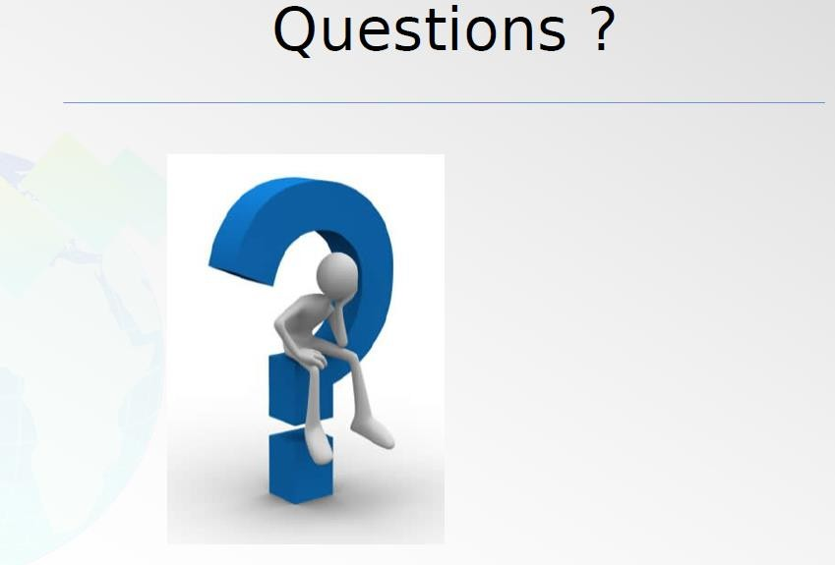

Slide 25
Performing a Risk Assessment
Lecture 4 Performing a Risk Assessment

